Slide 2
Welcome & Intro
Terry Murphy
Managing Director
Nielsen Media South Africa

Slide 3


proudly introduce
The most comprehensive
media study ever
produced in Africa
3 currency surveys
5 fused surveys
500+ Media vehicles
Over 1800 Brands
50,000+ Respondents

Slide 4
Fusion 2022 Studies
HUB

Slide 5
What you get in Fusion
1
2
3
PLATFORMS
PRODUCTS/ BRANDS
PEOPLE
TAMS +
ONLINE
FROM DCS
Banking
LSMS
TV
Print
Automotive
SEMS
Cellular
NLI
Digital
Food
Fashion
Furniture
Retail
DEMOS
Radio
FMCG
CPS AUDITED

Slide 6




Platforms & Overlap
TV
Print
Digital
Radio
TAMS Data
Online TV
Time-Shifted TV
OTT/Streaming
Newspaper/Magazines
Paper
Digital
Internet usage
Social Media
Devices/Apps
Tech in Home
Live Radio Listening
Online Radio
Streaming
Different Devices and Media Throughout the Day

Slide 7




Automotive
Number of Vehicles
Person Ownership/Usage
Make of Vehicle
Vehicle Obtained
In Household
Own or company car
Personally driven
New or second-hand
57
Vehicle Makes

Slide 8



Banking
Financial Institution
Main Bank
Credit Cards
Where accounts or cards are held
Which bank
Personal Usage
11
Financial Institutions
11
Banks

Slide 9




Cellular
Number of cell phones
Personal
Ownership
Type Used Most Often
Network Provider
Ordinary
Feature
Smartphone
Vodacom
Cell C
Telkom
MTN
In Household
Own or Use

Slide 10







Retail chains
Food and Grocery
Furniture and Appliances
Clothing
Store Cards
Stores where money is spent:
Most, Second most, Third most
Stores Purchased from
(Past 6 Months)
Personally own (for Loyalty points or Discounts)
Stores Visited or Purchased from
(Past 12 Months)
12
Stores
26
Stores
22
Stores
11
Loyalty Cards

Slide 11



People
LSMS
SEMS
DEMOS
SEM Groups
Socio-Economic Measure
1,3,5,10,20
LSM Super Groups
Living Standards
Measure
Demographic
Audience
Profile
GEOGRAPHY
GEOSEGMENTATION
Community size, Province, District councils
Neighbourhood Lifestyle Index
Super groups

Slide 12
REader Audience Data
Peter Langschmidt
Research Consultant
Publisher Research Council

Slide 13
Face 2 face is no longer representative or random
Beginning in about 2015, F2F has become increasingly unrepresentative due to many factors including increased security concerns, more security, greater time pressures, Covid and home office, higher internet penetration combined with lower cost, company subsidised and free data, and much more.
The inherent problems associated with F2F are primarily at the top end of the market. Due to spending power and higher CPT, this is where the bulk of advertsing money is spent. F2F has been undereading the upper SEM audiences for years.
Let’s look at how bad this problem is...
Notes:
Cheating interviewers , suburb whatsapp groups

Slide 14
Face-2-Face Undereads
1 INCOME
  GIS Audits proved conclusively that the
  ES and other F2F surveys are vastly undereading the top end of the market
40%+ UNDEREAD OF TOP END

Slide 15
HH Income
In 2018 an Audit with 3 Different GIS providers proved
that the ES was undereading the top 15% of HH by
around 40%.
The bottom underead was fixed by changing income questions from “salary” to “affordability”
Now 4 years later,
with increased living standards, higher internet penetration, hybrid work, will only have made things worse.
15

Slide 16
Face-2-Face Undereads
2 HH TYPE
3 LIFESTYLE
  All Dwellings with increased security like flats, townhouses, gated estates
  More bored/kind people who have the time and inclination to let strangers into their house for 40 minutes are sampled.
WAY FEWER SECURE COMPLEXIS
NO BUSY, WORKING PEOPLE

Slide 17
Online Vs. Oncouch
In Home Online Neither
0
0
0
Notes:
Census online

Slide 18


READ 2021
PAMS 2021 Online
Sample Size of 10 010
PAMS 2019 Offline
Sample Size of
4 720
READ 2021
Sample Size of 14 730
The PAMS 2021 Online survey was conducted using an Online Panel. Fieldwork collection covered 4.5 months, from mid-May to end-September 2021.
The full PAMS 2019 survey was conducted using a Face-to-Face methodology. Fieldwork collection covered 4 months, from August to November 2019.
Notes:
There is

Slide 19





STEPS TO PRODUCE READ21
Stacking
Imputation
Weighting
Calibration
Fill the missing
data points in the
PAMS 2021 Online Survey, based on
PAMS 2019 Online respondents
Extend the
PAMS 2021 Online Survey
by stacking the
PAMS 2019 Offline Survey
onto it to create
Total
(READ 2021)
Re-Weight the
READ 2021
at a Demographic level using GTI 2021 mid-year population estimates
Similar to weighting, but more target cells are used and convergence criteria are not as strict
1
2
3
2
4

Slide 20
STEPS TO PRODUCE READ21
1. IMPUTATION (fusion) Due to the fact that the survey was online, the length of the questionnaire had to be reduced.
To fill in the gaps due to the shorter questionnaire, Nielsen imputed the questions from the online component of the PAMS 2019 survey. Respondents who claimed to access the internet at least once a month in the PAMS 2019 survey, donated their data to the 2021 online respondents for questions that weren’t included in the PAMS 2021 online survey.
FMCG RETAIL ONLY BRANDS IN READ 2021
2. DATA STACKING Nielsen then added the imputed 2021 online sample to the 2019 offline sample to create a unified dataset that represents the total population of South Africa. To work correctly there must be no overlap between the two datasets.
Another key aspect is that both datasets must have identical questions and response codes. This is why the imputation step was so important because this ensured that the online sample was 100% consistent with the offline sample in terms of the questions.
Notes:
SUZUKI We cant do everything. NAAMSA Smart shopper every 100th – that’s 140,000 or ever 1000 that’s 14k
BANKS – CREDIT CARD NLI

Slide 21
STEPS TO PRODUCE READ21
3. WEIGHTING An individual respondent results are weighted back to be representative of the population at large. Respondents are placed in cells and weighted back in terms of Province, Community size, Age, Gender and Race.
4. CALIBRATION Calibration is a technique similar to sample weighting, but there are many more target cells required so the convergence criteria are not as strict as normal sample weighting. However, the calibration methodology that was used is capable of mixing different levels of control in terms of convergence.
The standard weighting variables referred to in the weighting section were treated as ‘hard’ targets in the calibration process. Additional variables were calibrated to ensure metrics such as internet penetration and access aligned with other data sources. These additional variables were treated as ‘soft’ targets and the full list of these variables are shown in the next slide.

Slide 22
STEPS TO PRODUCE READ21
4. CALIBRATION CONT’D
SEMs
Motor vehicle own/use/maintain
Home language
Work Status
Education
How often access the internet

Slide 23
Statement from Andrew Whitney,
Nielsen Data Science Lead
"This was a highly complex project that required a number of statistical techniques to be deployed. A team of 4 Data Scientists were involved over a period of 3 months, meticulously planning and checking each stage of the process."
"I’m proud of what the team has achieved and I'm confident that the results
are an accurate reflection of the readership behaviour in South Africa"

Slide 24
TRADITIONAL F2F PAMS VS. MIXED METHOD READ
STUDY PROFILE

Slide 25
TRADITIONAL F2F PAMS VS. MIXED METHOD READ
STUDY PROFILE

Slide 26
COMPARISON
STUDY PROFILE

Slide 27
NEW AIR METHODOLOGY
ONLINE
Just as PRINT CORE has been implemented to align readers more closely with circulation, we have applied the same principle to reduce Digital Past 7 Day and Past 4 Week readers to match industry Digital currency UB figures more closely. An advertiser is not going to reach the total P4W or P7D audience, so to get a more realistic measure we have applied probability to both the Recency and Frequency digital questions as shown in this table:
DIGITAL PROBABILITIES
LAST READ | PROBABILITY (A) | HOW OFTEN | PROBABILITY (B)
Yesterday | 1,00 | 4 or more times a day | 1,00
2 Days ago | 0,80 | 2 - 3 times a day | 0,71
3 Days ago | 0,62 | Once a day | 0,47
4 Days ago | 0,46 | 2 - 6 times a week | 0,28
5 Days ago | 0,33 | Once in the week | 0,14
6 Days ago | 0,22 | Less often | 0,04
7 Days ago | 0,13
8 Days - 2 Weeks ago | 0,06
3 - 4 Weeks ago | 0,02
Longer ago | 0,00

Slide 28
NEW AVERAGE ISSUE READER METHODOLOGY
PAPER
The CORE (Consistency Over Recency) sometimes referred to as FORE (Frequency over Recency) method uses the Frequency “number of issues” scale and assigns a probability to each of these that is then multiplied against the traditional Recency Readers at each level, as shown in the table below.
For example, for daily newspapers, a 5-issue frequency scale is applied, as there are five issues published from Monday to Friday.
DAILY NEWSPAPER - PAPER AIR CALCULATION EXAMPLE
FREQUENCY GROUP | PROBABILITY (A) | RECENCY READERS (B) | AIR (AxB)
1 OUT OF 5 ISSUES | 0,2 | 120 | 24
2 OUT OF 5 ISSUES | 0,4 | 115 | 46
3 OUT OF 5 ISSUES | 0,6 | 95 | 57
4 OUT OF 5 ISSUES | 0,8 | 158 | 126
5 OUT OF 5 ISSUES | 1,0 | 212 | 212
TOTAL READERS |  | 700 | 465

Slide 29


NO READER
COMPARISON
The new research methodology and readership calculations are vastly different from previous years.
This makes comparisons with
FUSION2020 or 2021IMU meaningless

Slide 30
Using Fusion22
With over 1,800 brands and 500 Media vehicles FUSION22 is the ideal media planning tool, especially for the first stages of profiling and understanding the Target Market, and then doing the inter medium comparisons.
During validation it has been checked to ensure that all stations and titles were within 2% of the currency donor studies, at the national level.
However always use the currency TAMS and RAMS when buying stations. The RAMS sample of almost 38,000 is robust enough to allow for regional and provincial analysis.

Slide 31
Television Audience Measurement Survey
Gary Whitaker
CEO
Broadcast Research Council of South Africa

Slide 32



What is TAMS
Geographically
represents SA TV viewing Households
Controlled by HH characteristics
Household Panel
of 3 134
Representing
TV households
15 876 571
Individuals (4+)
of +/-15 500
Representing
TV individuals
49 995 282
“To establish a common currency used by TV stations, media planners and advertisers for their advertising transactions, based on a reliable, independent and transparent audience measurement system”
* PAMS 2019 TV Universe estimates

Slide 33
Radio Audience Measurement Survey
Gary Whitaker
CEO
Broadcast Research Council of South Africa

Slide 34


What is RAMS AMPLIFY™
Geographically
represents SA Radio listening individuals in all Metro, Urban and Rural areas
CATI Day After Recall
which ensures greater
accuracy and access to
previously hard to reach population
groups
Individuals (15+)
of 37 721
Representing
Radio individuals
42 571 000
“To establish a common currency used by Radio stations, media planners and advertisers for their advertising transactions, based on a reliable, independent and transparent audience measurement system”

Slide 35
Consumer Panel Services
(Home Panel)
Terry Murphy
Managing Director
Nielsen Media South Africa

Slide 36

What is CPS
A continuous consumer household purchasing tracking tool
Demographically & Geographically
representative of all SA Households
Household Panel
of 3 680
Actual Audited Consumption
(not just claimed)
of HHs FMCG usage across all retail outlets

Slide 37



FMCG
Categories
Brands
Fused Data
167 Categories
1 678 Brands
Heavy, Medium, Light
Consumption
168 Categories
3 770 Brands

Slide 38
CPS GLOBAL FOOTPRINT
Over 230 000 Households in 24 countries
Finland
5,000
UK*
15,000
Germany
20,000
Canada*
12,300
France*
14,000
Switzerland
3,000
Spain
8,000
Italy
9,000
United States*
100,000
Greece
2.100
Portugal
3,000
South Korea
3,000
Israel
3,000
Hong Kong
1,500
Puerto Rico
830
Philippines
3,600
Mexico*
6,260
Brazil
8,000
Thailand
2,000
Indonesia
10,500
Colombia
4,000
Singapore
1,000
Australia*
10,000
Chile
2,000
South Africa
4,000
New Zealand
2,500
Updated March 2015
Home Scanner
Dustbin / Scan
Diary
Cash slip
Notes:
Samples are still important- and play a key role in any market research activity. Surveys in particular are easy to set up, and easy to execute.
But the problem is the viability of the single source panel. We need to be open to alternatives
Creating a fusion is still hard to do, but no harder than any other modelling solution
As the consumer landscape continues to fragment, and a growing need to see the whole picture, data fusion is a proven, and viable solution

Slide 39
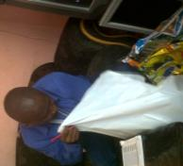

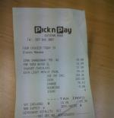
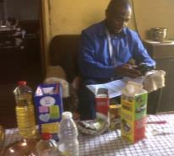
What Nielsen auditors do
1
2
3
4
Panellists Diary
Till Receipts
Pantry Contents
Nielsen Rubbish Bin
* URBAN HHs ARE AUDITED TWICE A MONTH, RURAL HHs ONCE A MONTH
New brands are automatically picked up with new incidence

Slide 40
Digital Consumer Survey
Terry Murphy
Managing Director
Nielsen Media South Africa

Slide 41



What is DCS
Demographically & Geographically
National Survey
Adults, 15+
Online Panel
Internet used in
past week
Individuals
3 000 respondents
Measures digital usage across all platforms, and information about online behaviour

Slide 42





Media
Online and offline activities
TV & video viewing behaviour
Online radio listening vs broadcast radio
Online news & magazines vs print edition formats
Podcasts
Social Media
Shopping
Gaming
Content and Platforms
Technology
DIL
VOD Platforms & Bands
Content & programmes watched
Devices
Apps
Websites/platforms
Hours Frequency and Place
“Day in the life of”

Slide 43
Video media activities in the past month
Base: all adults

Slide 44
Online platforms used for watching TV programmes or movies
Base: all adults

Slide 45
Online platforms used for watching TV programmes or movies
Base: online universe

Slide 46
Faster, Cheaper and Free Data is Driving the Streaming Revolution
SOURCE:DCS 29,6M internet users
R11 358
38 years
R20 947
33 years
R25 324
33 years
Based on 12 month Readers
Notes:
1 GB for 30 days down to R85, and specials for night time and shorter validity.
Hundreds of thousands of wi fi spots, not just in restaurants but in public places and transport hubs
Companies supplied modems and computers to staff during covid
6.5m people on Moya – while not streaming video, free apps provide a free gateway to experiencing the power of the internet SEARCH TODAY, STREAM TOMMOROW Peter L

Slide 47
Work Location
UNIVERSE: Work full time and internet past month 10.7M
Less Industrial, Agricultural, Transport, (Retail) Services 2.8M
Exclusively
from home
1.8m
23%
Exclusively
from office
3.5m
44%
Both
2.6m
33%
SOURCE:DCS 7.9M internet accessing “office workers”
R11 358
38 years
R20 947
33 years
R25 324
33 years
Based on 12 month Readers
Notes:
Ran this on Advertising and marketing and percentages where the same

Slide 48
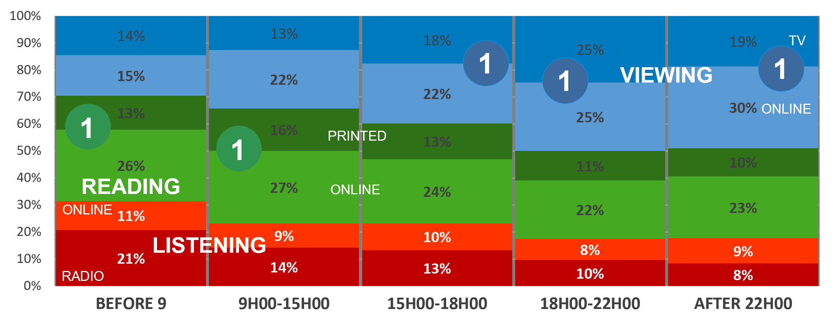
Activity by Platform by Daypart 2019
Total Adults (Online Universe)
SOURCE: PAMS BRANDS PPP 2019
Past Month Online Universe. Activities aggregated and profiled. Reading is News and Magazine only

Slide 49
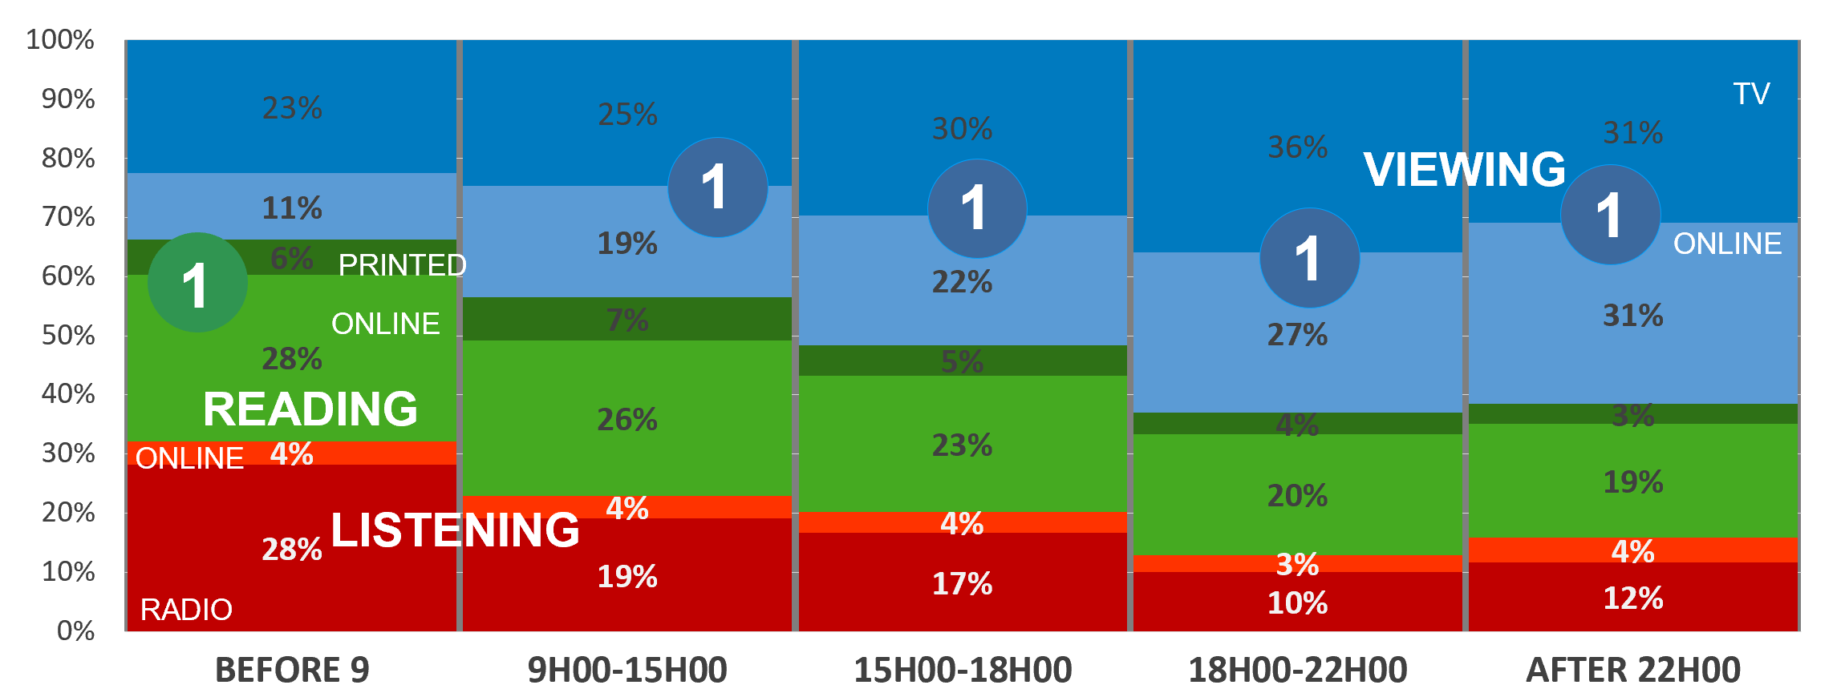
Activity by Platform by Daypart 2020
Total Adults (Online Universe)
SOURCE: FUSION 2020
Past Month Online Universe. Activities aggregated and profiled. Reading is News and Magazine only

Slide 50
Activity by Platform by Daypart 2022
Total Adults (Online Universe)
1
1
1
1
VIEWING
READING
1
LISTENING
SOURCE: FUSION22
Past Month Online Universe. Mon- Sun . Activities aggregated and profiled. Reading is News and Magazine only

Slide 51
Fusion & Online Overview
Jonathon Wells
Senior Vice President Data Science
Nielsen Media International

Slide 52
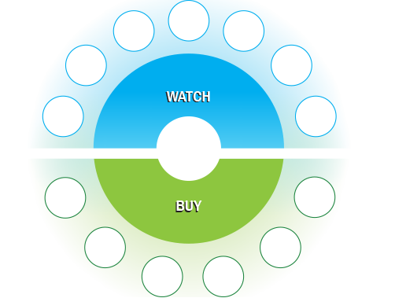












State of the Industry (2018)
The continued challenge of fragmentation
PC
NEWSPAPER
SMART TV
MAGAZINE
RADIO
TABLET
LAPTOP
CREDIT
E COMMERCE
CASH
STORE
TRADITIONAL TRADE
CATALOGUE
Notes:
Single source measurement- panels, diaries and surveys- was the backbone of market research in the 20th century. We measure activity in a small subset of the population and project results out against a Universe estimate. These data sources are great- they give us the advantage of being able to directly link activity to deep and rich demographic information.
Here is the problem. The number of paths consumers can take to consume media and purchase products has expanded rapidly in the last 20 years; the notion of Fragmentation. Look at all the ways people consume advertising. Look at all the ways they now purchase products.
All of the various permutations and combinations of consumption make traditional survey-based measurement more difficult.
Why? Because expecting people to record everything they do - everything they do - is a big ask…... It’s hard to remember, and it’s time consuming.
So as markets continue to fragment
We need More questions to understand complexity and brands which means Longer questionnaires
The increased burden leads to Fewer respondents per question AND Poorer quality of responses
Couple that with the ever growing challenge of declining response rates and participation- driven as much by increasing awareness of personal privacy as the onus of participation as- and you quickly appreciate why it is harder and harder for individual surveys or paper diaries to give us pervasive measurement.
What we face is a limitation in scope. Coverage is being compromised. Think of it like this, given all of the options people have, how likely are we to observe a specific combination of exposures and actions directly in a single sample?
Ideally, marketing researchers would like to have large, unbiased, representative samples of consumers available so all marketing influences, such as purchase behaviour, TV and print advertising exposure, attitudes, opinions and lifestyles, etc, could be measured. And, in this ideal world, the impact of these influences all would be measured on the same sample of consumers.
Realistically, however, such complete data are not available, or are impractical to collect from a single consumer.
But here is the good news- we are living in an information age. There are a multitude of data sources available; Panels, surveys and the emergence of “Big Data” are all established to capture a piece of the puzzle. As a market researcher, the challenge lies in finding a logical and robust way to thread those assets together and build a complete view of the individual, one that incorporates all of the behaviors we seek to quantify and understand.
The science has come a long way here, and continues to evolve. What we are seeing with the READ22 product is a reflection of that evolution.

Slide 53




Data Inputs
RAMS
BRC
TAMS
BRC
READ PRC
CPS
Nielsen
DCS
Nielsen
Notes:
Given the data assets available in South Africa, the most appropriate technique to combine these is Data Fusion!
Data fusion uses common variables to match two or more datasets at the respondent level and create one unified database. The combination happens by appending one set of data (donor) onto the other (recipient)
Key benefits of data fusion include:
Ability to link existing “currency” databases
Minimizing cost and respondent burden of data collection
Creates a respondent-level database that allows for flexible analysis, including cross-media reach and frequency

Slide 54




Survey Methodology Overview
There are 4 primary modes of data collection
Survey mode matters as each has features that make it more or less prone to different sources of error.
When deciding on a survey mode, you should consider the target population and use case.
There are trade-offs between cost, speed, and data quality.
Mail
Phone
Web
In-Person
Notes:
In lieu of the availability of large scale, high quality, representative Big Data Sets, READ21 continues to rely on survey methodology as a key element of our data collection approach.
Overview - Modes of Data Collection
Four primary modes of data collection: Mail, Phone, Web, Face-to-face
Mode matters as each has features that make it more or less prone to different sources of error
Ex: presence of an interviewer can lead to measurement error due to social desirability bias
Ex: you will have undercoverage of the general population if you are administering a survey only via landline phones
When deciding on mode, you should consider the target population and use case (e.g., needing point estimates vs. conducting exploratory research)
There are trade-offs between cost, speed, and data quality

Slide 55



Online methodology
General population web surveys face sampling and coverage challenges
Challenge
Solution
No sampling frame for email addresses for general population
Coverage limitations with internet for general population
Utilize web surveys as part of a sequential mixed-mode design
Select a sample of addresses from a sample frame with high coverage
Mail “push-to-web” invitations to the selected sample
Use other modes of data collection for non-responders to minimize bias
Notes:
The innovation this year is the shift to heavier reliance on an Online methodology
Web surveys offer benefits in terms of data collection:
Lower costs
Minimizes biases from interviewer effects
Allows for flexibility in questionnaire design (e.g., complex skip patterns and randomizations)
Coverage and sampling limitations present challenges with general population web surveys
No sampling frame for email addresses for general population
Coverage limitations with internet for general population
However, the role of web surveys has been evolving with many organizations within the US moving toward a sequential mixed-mode recruitment methodology that utilizes an initial push-to-web invite followed by other modes of data collection
Using web surveys as part of a sequential mixed-mode design
Within the US, the federal government and many research organizations (including Nielsen) rely on the USPS Delivery Sequence File (DSF) to build an address-based sampling frame that is representative of US households.
Because the primary sampling unit is the address, your data collection approach has to take this into account.
Traditionally, this often meant relying on face-to-face surveys for high quality surveys, but organizations are now moving toward mixed-mode recruitment methodologies that utilize web first and save face-to-face interviews for non-responders

Slide 56
Countries Using Online Methodology
North America Asia Pacific Europe MEAP* Latin America
*MEAP: Middle East, Africa and Pakistan
Notes:
Media Fusions are a common practice around the world. They are relatively easy to apply in instances where multiple data sets with a set of common characteristics exist
US - Census bureau Decennial Census: multiple-mode census, using mail, telephone, internet, face-to-face, and other modes as they emerge
Australia - moved from 100% F2F to 100% online in 2006
NZ - mixed methodology (F2F + online) was introduced in 2016, now 100% online since 2020
Singapore - 100% F2F until 2020, moved to mixed methodology with a 50/50 split between F2F and online
Malaysia - 100% F2F until 2021, moved to mixed methodology with a 50/50 split between F2F and online

Slide 57
Online methodology
Key Takeaways on Web Surveys
There is a time and a place for web surveys
Many organizations are starting to embrace online data collection within their probability-based framework
For standalone web surveys, it’s important to consider the use case and different sources of error

Slide 58

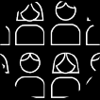


WHAT IS DATA FUSION?
Statistical analytics and modelling in order to create a single data set that incorporates the attributes from multiple sources
Data Set 1:
(recipient)
Print Title
Reading
+ Platform
Data Set 3:
(integrated)
Print Title FMCG
consumption
profile by platform
Data Set 2:
(donor)
FMCG brand consumption
Notes:
Given the data assets available in South Africa, the most appropriate technique to combine these is Data Fusion!
Data fusion uses common variables to match two or more datasets at the respondent level and create one unified database. The combination happens by appending one set of data (donor) onto the other (recipient)
Key benefits of data fusion include:
Ability to link existing “currency” databases
Minimizing cost and respondent burden of data collection
Creates a respondent-level database that allows for flexible analysis, including cross-media reach and frequency

Slide 59

Fusion in Practice
The importance of linking variables
OWNS A HOME
WATCHES TV
AGE
DRINKS WINE
GENDER
SUBSCRIBES TO THE DAILY DISPATCH
OCCUPATION
RACE
READS MAGAZINE
LIKES TO TRAVEL
EDUCATION
INCOME
LISTENS TO RADIO
SHOPS ONLINE
LOCATION
FOLLOWS RUGBY

Slide 60

Fusion components
Television viewing
behaviour
TAMS
BRC
Data Set 1:
Demos & Publications by platform
RAMS
Radio
Listening
RAMS
BRC
READ PRC
CPS
Nielsen
FMCG
brand
consumption
DCS
Nielsen
(56 219 Respondents)
(14 730 Respondents).
Digital
Consumer Survey
DONOR
+
RECIPIENT
=
FUSION
Notes:
We need to “fragment” some recipients in order to make sure we use the Best Match for every donor

Slide 61
Media Fusions Around the World
Market | Components of Fusion | Frequency
Australia | CMV + TV + Radio + Online | Monthly
Indonesia | CMV + TV | Monthly
Malaysia | CMV + TV | Twice Yearly
New Zealand | CMV + TV + Online | Monthly
Philippines | CMV + TV + Radio | Monthly
Singapore | CMV + TV + Radio + Online | Monthly
Market | Components of Fusion | Frequency
Italy | TV + Print | 3/ Year
USA | TV+ Digital | Monthly
Denmark | Broadband + Non-Broadband | Daily
Germany | Purchasing + Digital | On Demand
USA | TV + Digital | Monthly
USA | Mobile + Online | Monthly
Note: CMV is Nielsen’s Consumer and Media View survey (similar to READ21), which provides insights into media habits, lifestyle, attitudes and product consumption.
Notes:
Media Fusions are a common practice around the world. They are relatively easy to apply in instances where multiple data sets with a set of common characteristics exist

Slide 62
Thanks and Closing
Peter Langschmidt
Research Consultant
Publisher Research Council

Slide 63
Thanks & Closing
Questions
Zoom please put in chat box or email peter@prc.za.com and we will answer via email tomorrow morning
People here, we can chat over a Fusion Cocktail
30 Agency & Client Workshops
With the Doyen of Media Planning & Training Gordon Muller
Contact your media rep to set up a time
FUSION22 Release 10am Friday 21st October
Notes:
Poll results
THANKS
To all of our agencies and clients, members and partners for attending today – most appreciated
Nielsen USA Jonathan Wells. Less than 0,5% Jonathan's fusion preso will be on the BRC and PRC websites
Nielsen Australia Andrew Whitney and the team of data scientists
Nielsen SA Terry Murphy, Richard Newcombe , Hank Bento, Sonja de Jong
BRC Gary Whitaker
Validators Lauren Shapiro and Karen Phelan
Michelle Kirby and the team from Orange Block

Slide 64
Want FUSION 22 data – email SAsupport@nielsen.com

